Slide 1
Game BlobBlob
By Vlad Mihai Vasile
Supervisor – Steve Pettifer

Slide 2
Description
3D Game in Unity (game development platform)
2 different characters that rely on each other (similar to Water Girl Fire Boy)
get past enemies who threaten them and obstacles
Goal: both get out of the maze alive

Slide 3
Project purpose
try something new, challenging and fun as 3rd Year Project
create a game that brings people together
make memories while playing with friends

Slide 4
Planning
- ensure working MVP
2 characters working properly, 2 types of enemies (C & R), 2 types of power-ups (Shield, Heal)
- 3 more types of enemies(Tank, Pirate, Sniper), maze puzzles, more power-ups
Extra Features (if time allows them)
- use better VFX and SFX
- add more levels
- create more kinds of enemies/power-ups to increase complexity

Slide 5
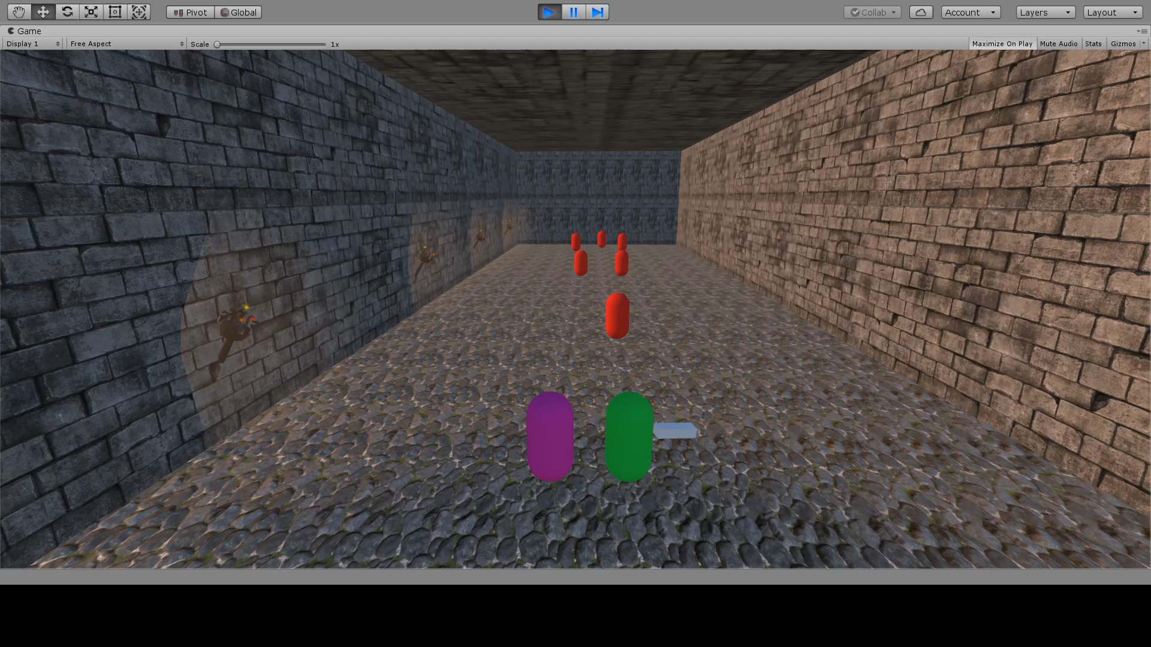

Slide 6
Thank you
for your attention

